Slide 1

ARDUINO SUMMER CAMP
SOUTH TEXAS COLLEGE

Slide 2
NICHOLAS HINOJOSA
South Texas College Computer Science Instructor
Bachelor’s in CIT
Masters in IT from UTPA
Certifications from Cisco (CCNA, CCENT)
Certification from SANS (GSEC)
Certification from CompTIA (Security+)
Certificate from Google (Google IT Support Pro)
Programming I, II, III, C Programming
Survey of Programming, Advanced Web Design
Advanced Networking, Database Management
Internet/Internet Server Integration
Fundamentals of Information Security

Slide 3
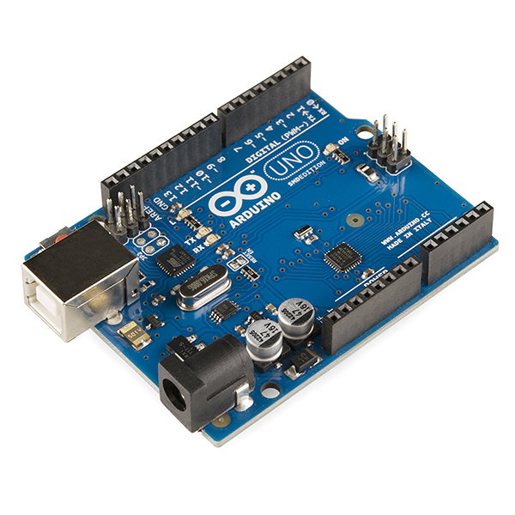
ABOUT SUMMER CAMP
Physically programmable microcontroller
Create electronic projects with hardware and software
Connects with input and output devices, such as ultrasonic distance, LEDs, motors, LCD screens, push buttons, temp sensors, phototransistors, etc.

Slide 4
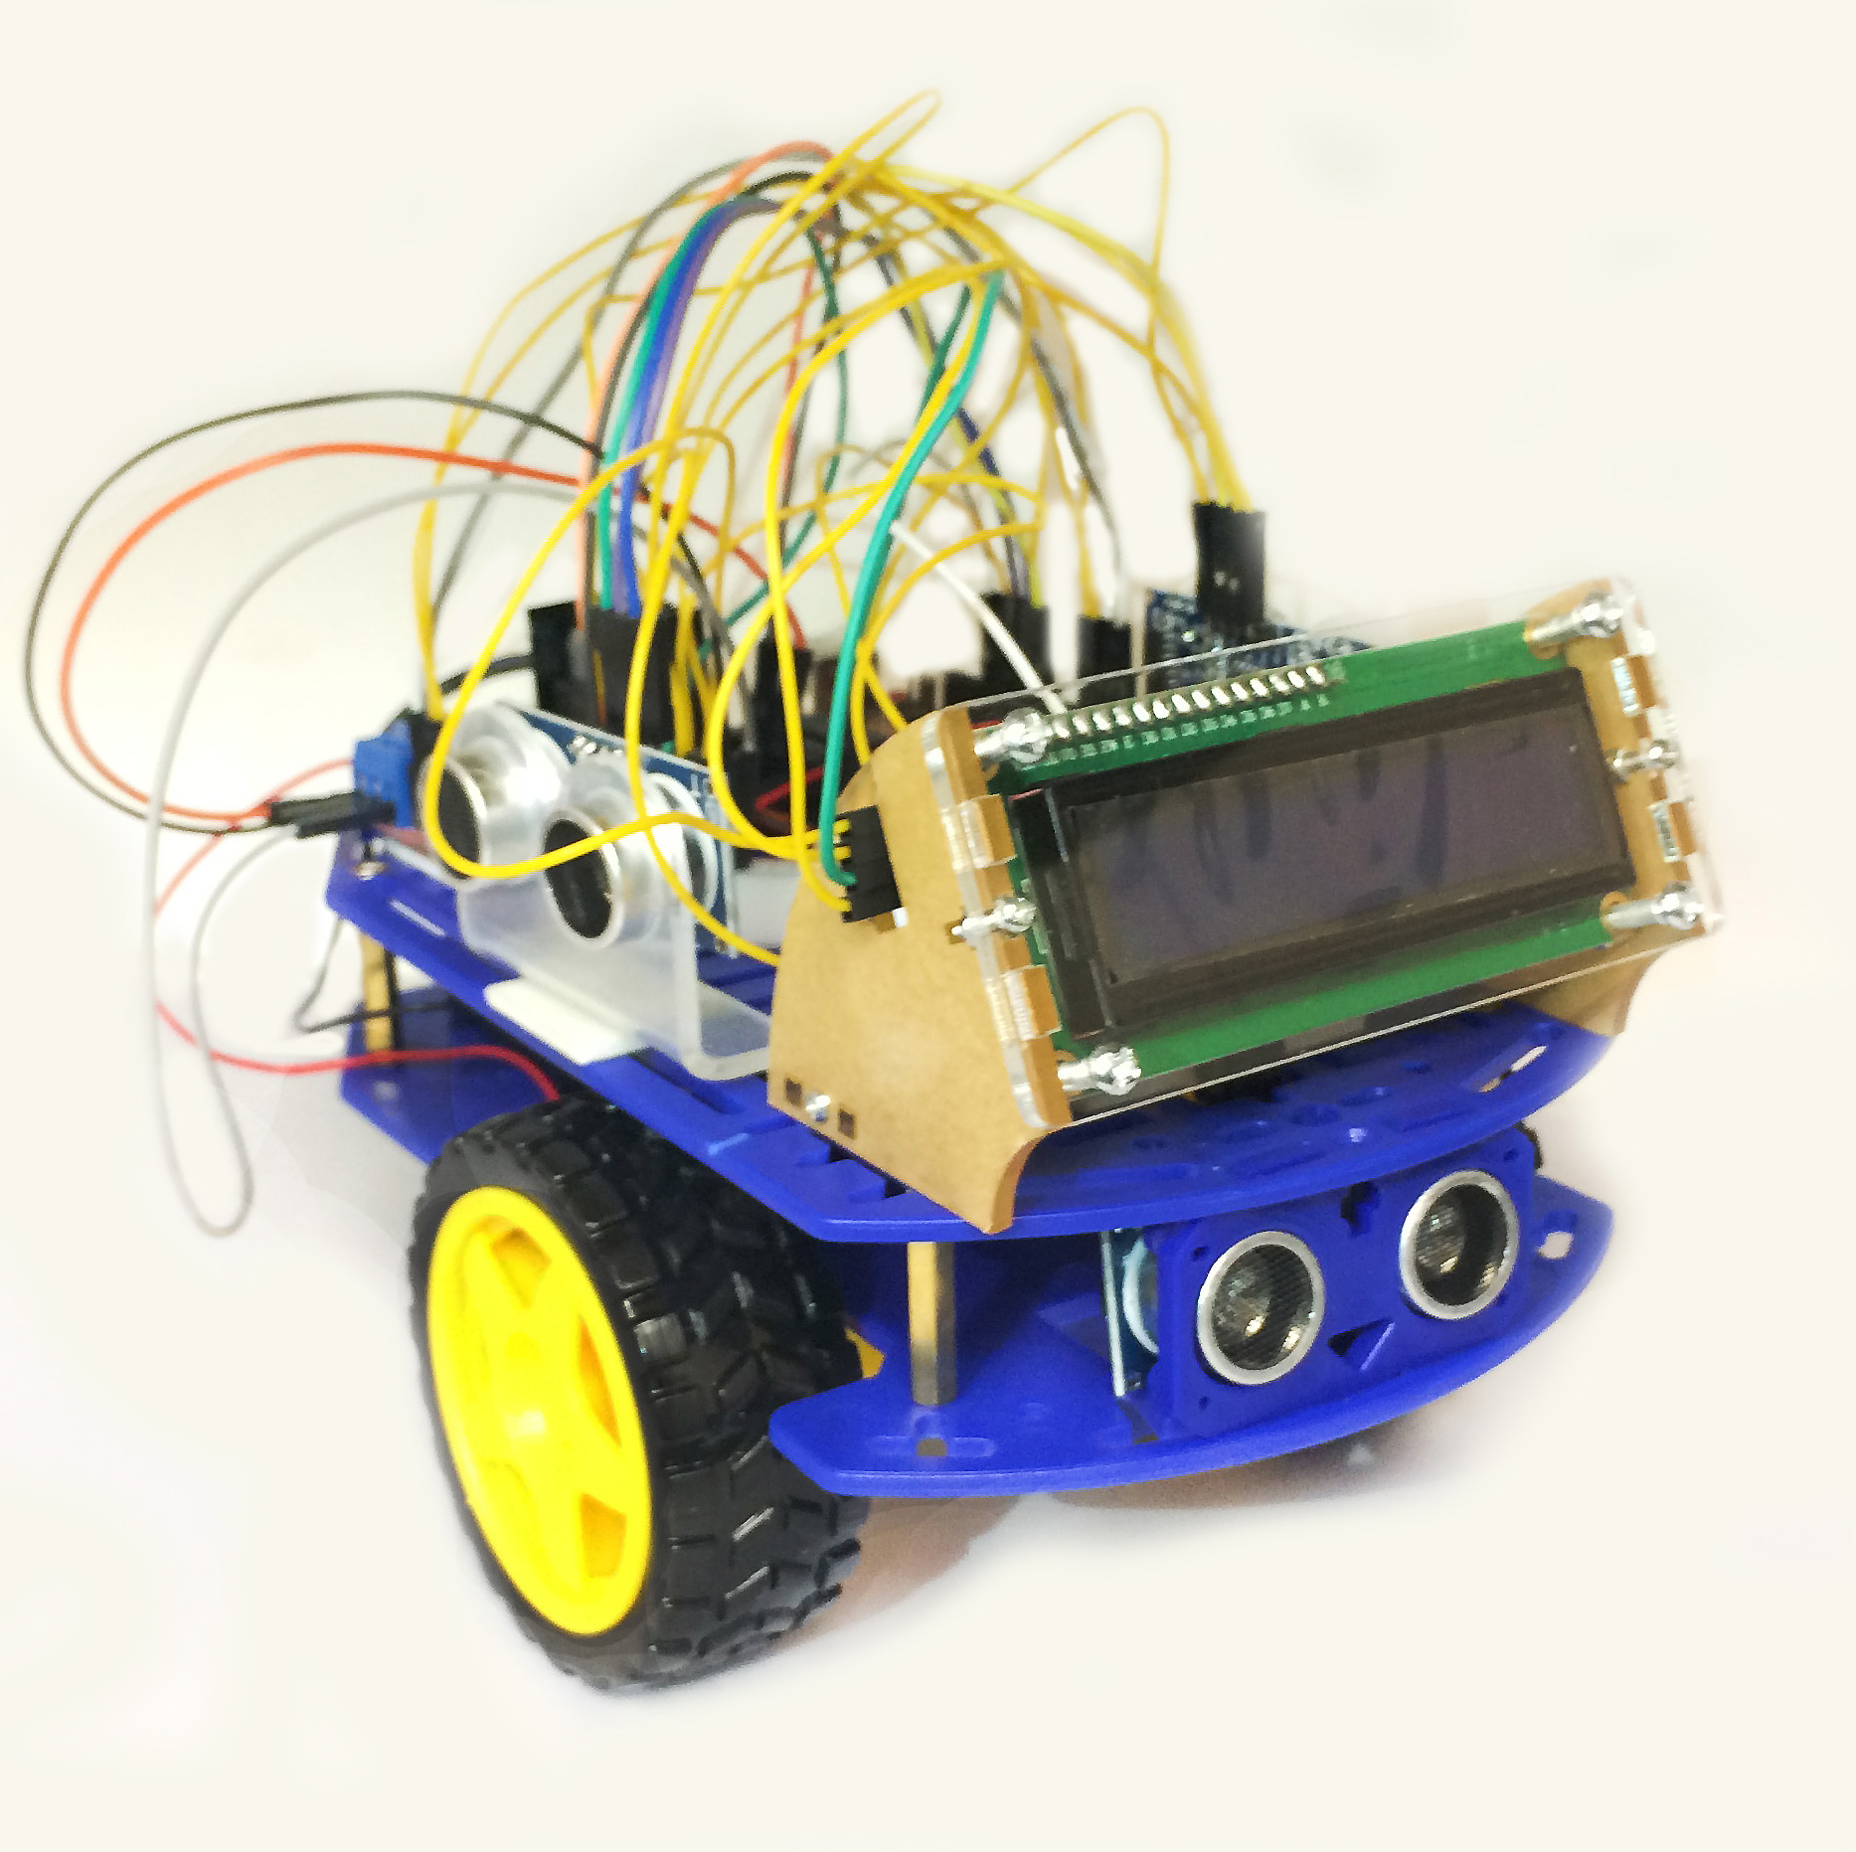
What you will need
Arduino Smart Car Kit (Mailed)
Laptop or Desktop
Scissors
Arduino IDE (web or installed)
Setup Account with TinkerCad
https://github.com/nhinojosa/SummerCamp2021

Slide 5
Day 1 – Getting Started

Slide 6
What is electricity
Type of energy
Flows through conductors (wire)
electricity can turn on a light, noise from speaker, or move a motor
Circuits are closed loops of wire with a power source (battery)
There needs to be a complete path from the energy source (power +) to the point of least energy (ground - ) to make a circuit.

Slide 7
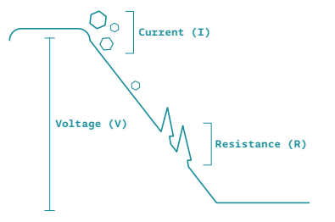
Parts of Electricity
Current – amount of electrical charge flowing past a specific point
Voltage – difference in energy from one point in a circuit and another
Resistance – how much a component resists flow of electricity

Slide 8
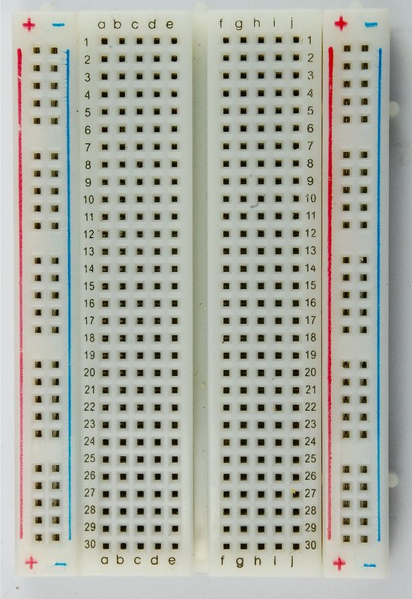
Breadboard
Create circuits and connect components using jumper wires
Power bus – vertical strips are electrically connected.
Horizontal rows are electrically connected
Middle sections breaks the connections between both sides.

Slide 9
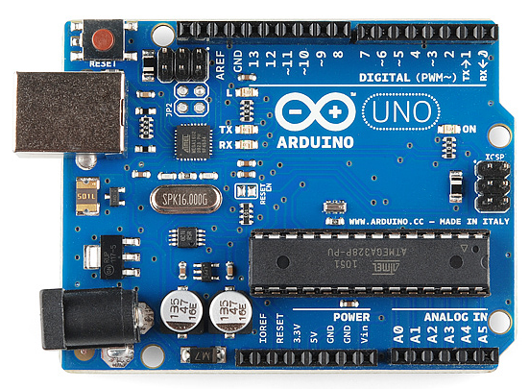
Arduino UNO
Power Connector
USB Port
Reset Button
Digital Pins
Pin 13 LED
Atmega Microcontroller
Power LED
GND and 5V Pins
Analog In Pins

Slide 10
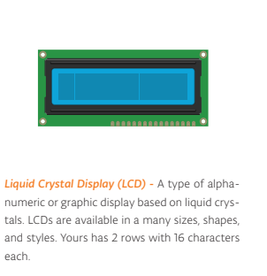
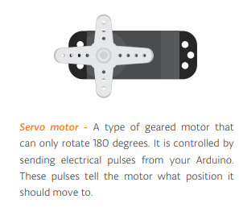
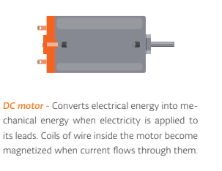
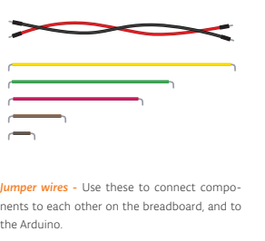
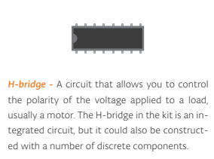
Other Components

Slide 11
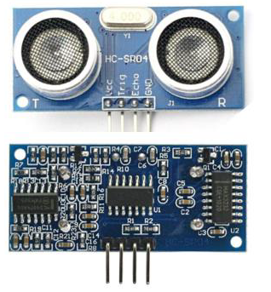
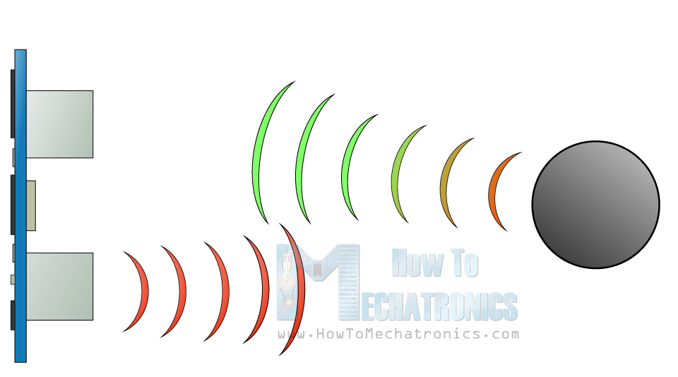
HC-SR04 ultrasonic sensor
The HC-SR04 ultrasonic sensor uses SONAR to determine the distance of an object just like a bat.
Accuracy range is 2 cm to 400 cm

Slide 12
How sonar works
A sonic burst is sent out
Travels at speed of sound and the sonic burst will bounce back from the object and it will be received
The speed of sound is 0.034 cm per microsecond
To get distance, the time received is multiplied by 0.034 and divided by 2

Slide 13
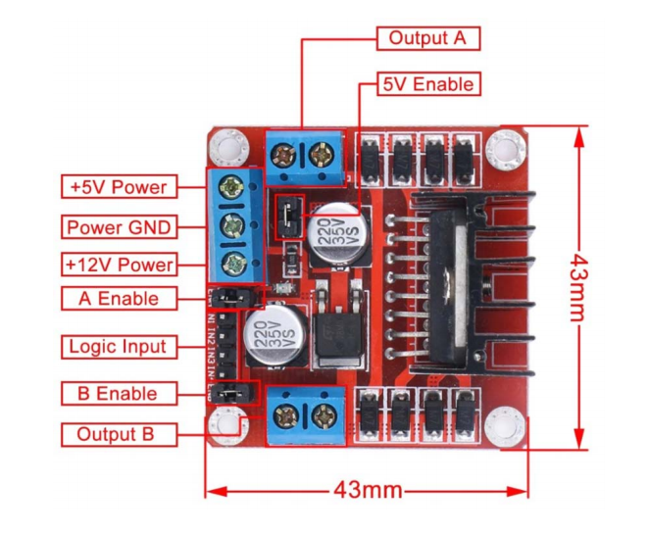
L298N Dual H-Bridge Motor Driver
The circuit will allow you to easily and independently control two motors.

Slide 14
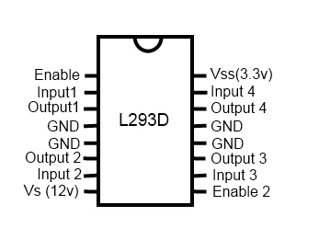
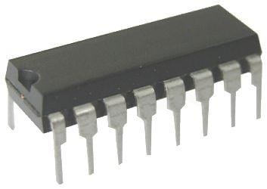
L293D Motor Driver
This is similar to the L298N but requires a breadboard
This is the one we will use in the simulator.
It’s harder to connect

